Slide 1

Brand Guidelines

Slide 2
Primary Logo
The following examples show proper usage of the RiverMeadow logo in full color.
The RiverMeadow Logo can not be redrawn or recreated from separate graphic and type elements. Reproduction of the RiverMeadow Logo can only be achieved by using the official master artwork files.
The full-color RiverMeadow Logo will always appear on white background. The RiverMeadow Logo must appear at least once on all communication media.
Changes to the RiverMeadow Logo are not allowed (e.g., graphic effects, shadows, inner-glows or other graphic elements).
With tagline
Whenever possible, use the treatment of the RiverMeadow logo that includes the tagline
Without tagline
This treatment should be used when the logo placement is too small for the tagline to be legible, or when the available vertical space does not allow for it.
Click here for logo folder (link coming soon)

Slide 3

Secondary Layout
In situations where the available space prohibits the use of the primary logo, the secondary, horizontal layout may be used.

Slide 4


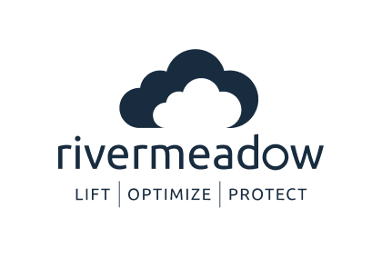
RiverMeadow Light
RiverMeadow One-Color White
Secondary Color Treatments
The following examples show proper usage of the RiverMeadow Logo in secondary color treatments.
It is essential that the RiverMeadow Logo be placed on the correct background. When placing the RiverMeadow Logo against darker backgrounds, the Logo should be light.
In situations where the logo must be printed in one-color, or where portions of the primary or light logos are illegible, the white or dark logo may be used.
RiverMeadow One-Color Dark

Slide 5



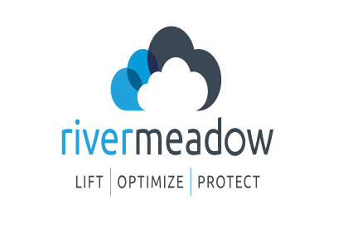


Incorrect Logo Usage
Avoid backgrounds that dilute the readability and effectiveness of the Logo.
Never re-draw the RiverMeadow Logo, alter its shape with filters or other software, or try to recreate it using a font.
It would be impossible to list in this guide all of the accepted uses and all of the misuses for the RiverMeadow Logo. Use common sense and the basic principles of this style guide when representing the Logo.
The following examples show some common misuses of the RiverMeadow Logo.
Do not skew the logo
Do not place the Logo on a similar color background
Do not angle the Logo
Do not stretch or squash the Logo
Do not place the Logo on a busy pattern
Do not rearrange the Logo

Slide 6
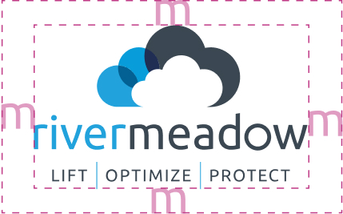

Clear Space Requirement
The minimum clear space around the Logo should equal the width of the letter “m.”
The clear space requirements displayed on this page are intended to maintain the integrity of the RiverMeadow Logo by ensuring an appropriate amount of space around the logo.
No other elements should infringe on the clear space of the Logo.
The clear space requirements act as a ratio. The larger the Logo, the larger the minimum clear space around it should be.
The letters in the RiverMeadow Logo should never be smaller than the main body text in the document.

Slide 7
Primary Colors
One of these colors should be the dominant color in all collateral.. They can be combined with one another, or with a secondary color.
Use of white space is important for the Metazoa brand. Do not overuse the colors.
Bright Blue
Deep Gray
PANTONE 2925 C
RGB: 0, 163, 230
CMYK: 100%, 29%, 0%, 10%
HEX: #00A3E6
PANTONE: 7546 C
RGB: 55, 71, 89
CMYK: 38%, 20%, 0%, 65%
HEX: #374759

Slide 8
Secondary Colors
These colors should only be used if a primary color is already present. They are designed to complement the primary colors.
Use of white space is important for the RiverMeadow brand. Do not overuse the colors.
Pale Blue
Dark Blue
PANTONE 656 C
RGB: 230, 240, 252
CMYK: 9%, 5%, 0%, 1%
HEX: #E5F0FDFF
PANTONE 534 C
RGB: 32, 46, 84
CMYK: 62%, 45%, 0%, 67%
HEX: #202E54
Deep Blue
White
PANTONE 7691 C
RGB: 3, 98, 148
CMYK: 98%, 34%, 0%, 42%
#036193
PANTONE 000 C
RGB: 255 255 255
CMYK: 0%, 0%, 0%, 0%
HEX: #FFFFFF

Slide 9
Gradients
These gradients should only be used if a primary color is already present. They are designed to complement the primary colors.
Use of white space is important for the RiverMeadow brand. Do not overuse the gradients.
Pale Blues
Green-Purple
HEX: #F1F8FFFF - #E2EFFFF
HEX: #DEF3ECFF - #E0E3fA

Slide 10

Primary Typography
Typography is an important part of The RiverMeadow Logo system.
Consistent use of typefaces in all RiverMeadow communications will demonstrate RiverMeadow’s commitment to consistency and professionalism.
Aeonik
Our primary font is Aeonik. Use medium weight for headings, Normal weight for body text.
Download Here (NEED FILES)
Designed by Mark Bloom and Joe Leadbeater

Slide 11
Secondary Typography
Ag
The secondary typography may be used in cases where the primary font is unavailable. Examples include Google Slides and Docs.
DM Sans
Our secondary font is DM Sans. Use semi-bold for headings, Normal weight for body text.
Download Here
Designed by Colophon Foundry

Slide 12
Thank You
If you have further questions regarding this brand guide, please contact Jill Hourani, VP Marketing: jhourani@rivermeadow.com

